Slide 1
Professional tools and workflows
for theme development

Slide 2
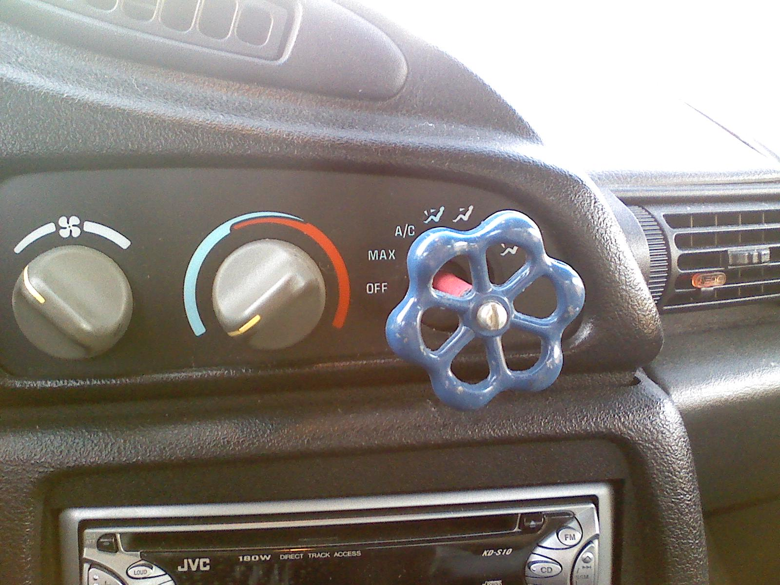
When you boss said
“We’re in a hurry.
So do a quick fix for it”

Slide 4
More problems
Lite version
WP.org version
Child themes

Slide 5
Each version requires
CSS/JS minification ??
Image optimization ???
PHP/JS/CSS proper code styles ??
Backward and cross product compatibility ??
Proper textdomains ??
Version management ???
......

Slide 7
Grunt task types
Checking tasks checktextdomain phpcs jshint phplint | File processing tasks addtextdomain imagemin makepot phpcbf postcss wpcss

Slide 8
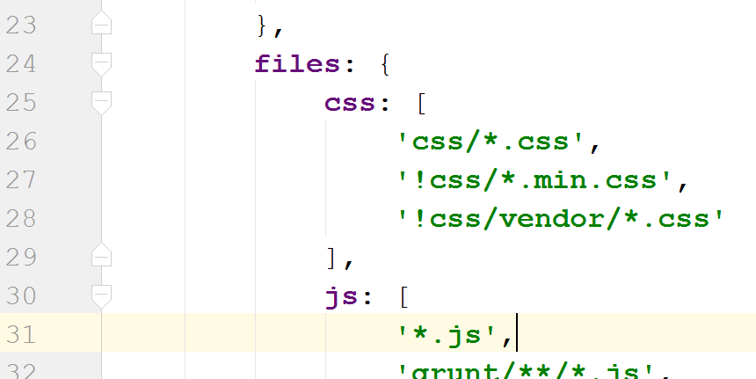
Gruntfile.js

Slide 9
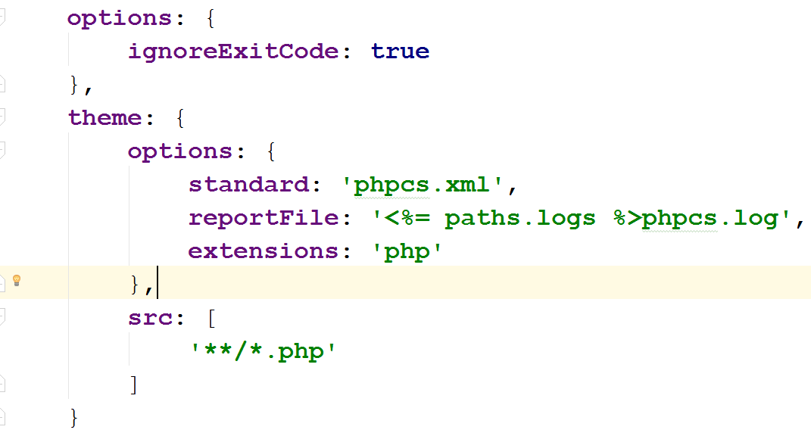
Task files

Slide 10
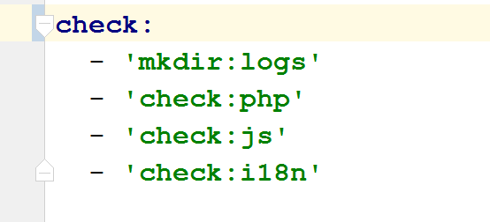
Build workflows
Task definition file
Group tasks for each type of actions
Code check specific tasks

Slide 11
Tasks specific configuration files
.jshintrc - jshint ruleset ( WordPress standards )
phpcs.xml - phpcs ruleset ( WordPress standards )
.distignore - files to be ingored on release ( grunt files, rulesets, etc … )

Slide 12
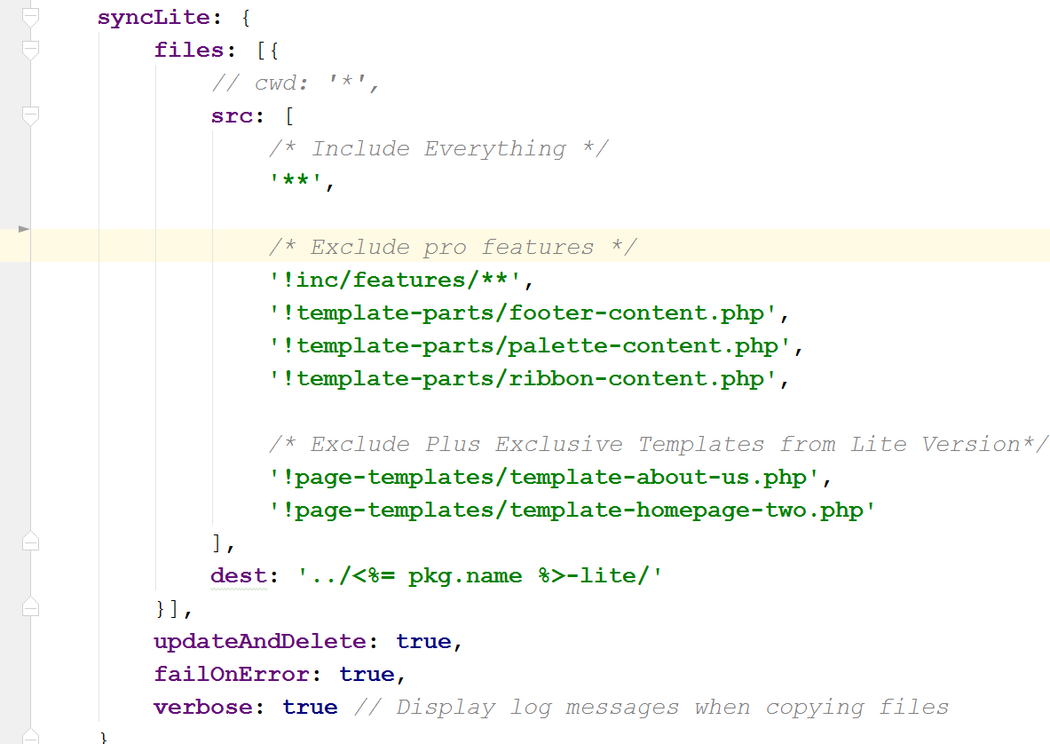
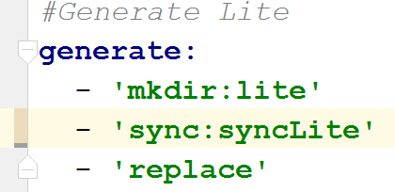
Generate lite version

Slide 13
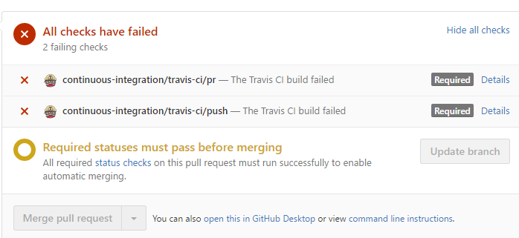

Slide 14
Testing multiple environments

Slide 15
Release pipeline
clone on deployment server the master branch
Update changelog based on the pull request message
github master branch merge
rm redundant files (.distignore rules)
zip for release
deployment server triggered via git webhook
grunt generate
copy to demo servers
Update version on store

Slide 16
Conclusions
Automate all your repetitive work
Say NO to quick fixing, Spend time on testing !
Research before developing

Slide 17
Thank you !
Marius Cristea
marius@themeisle.com
http://bit.ly/themeisle-themes

